Slide 1


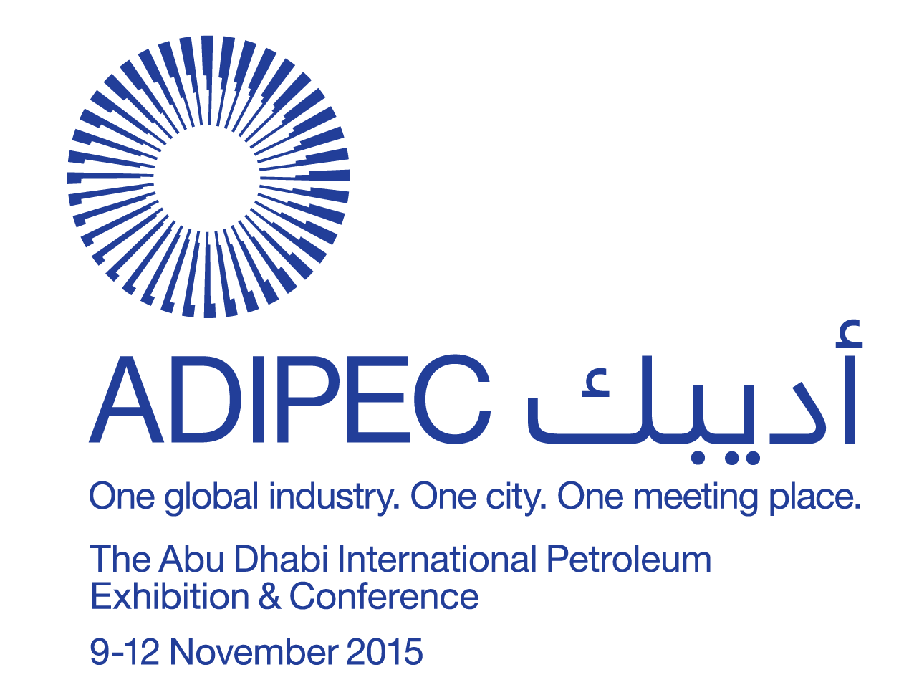



Slide 2
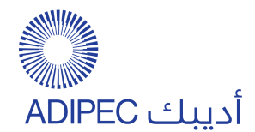


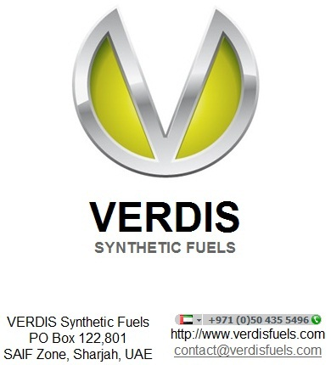
SPE--MS
Optimum Process Design for Gas Conversion to Wax-free Hydrocarbons
Dr. Conrad Ayasse, PhD, FCIC

Slide 3
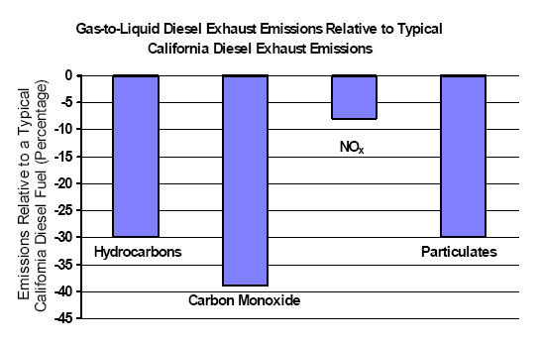
The value of synthetic fuels:
Reduces air pollution
FT Diesel = Reduces Foul Vehicle Emissions
Zero sulphur and aromatics

Slide 4
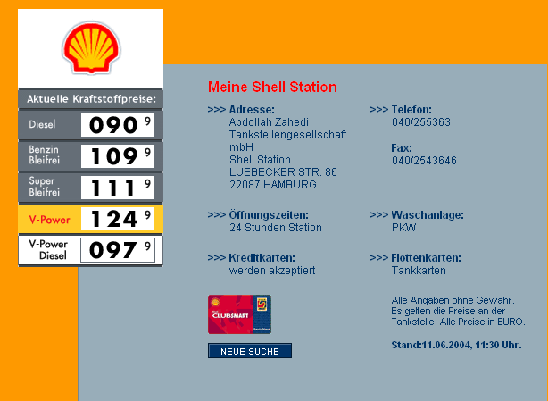
FT Diesel Retail Sales in Europe (2008)* Fetches higher price
(5% GTL ~ €7¢/ltr)
(5% GTL ~ US 26¢/gal)
(100% GTL ~ €1.40 /ltr)
(100% GTL ~ $5.30/gal)
(100% GTL ~ $222/bbl)
*AN ALASKA NORTH SLOPE GTL OPTION – BY ANRTL

Slide 5
The fischer tropsch process
Polymerization of carbon monoxide
nCO + 2n H₂ = (-CH2-)n- + nH₂O
Δ H = -165 kJ/mol
Highly exothermc
Possible paraffinic chain length C₂-C₆₀
SPE-xxxxxx-MS • Optimum Process Design for Gas-to-Diesel Conversion• Dr. Conrad Ayasse

Slide 6
The traditional approach
A typical FT plant
converts natural gas to synthesis gas
(CO+2 H₂)
Then makes the maximum amount of wax
which is hydrocracked to products
including NGLs, naphtha, diesel and lubricants
SPE-xxxxxx-MS • Optimum Process Design for Gas-to-Diesel Conversion• Dr. Conrad Ayasse

Slide 7
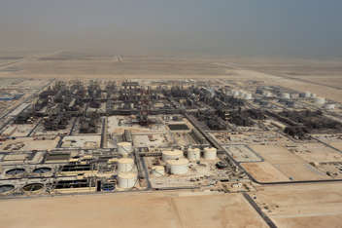
Shell Pearl GTL Plant, Qatar

Slide 8
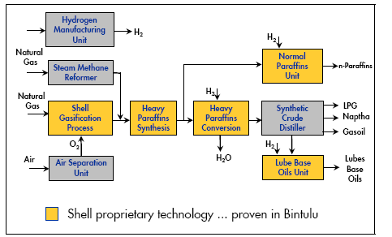
ECONOMICS OF THE VERDIS GTD PROCESS
SHELL BINTULU
16,000 bpd
VERDIS OFFSHORE
2000 bpd
V-CPOX
GTD
Diesel
Verdis Technology
Simplicity and capital cost reduction
through elimination of operating units
SPE-xxxxx-MS • New Syngas Reforming Solutions for Enhanced Gas to Diesel Conversion • Dr. Conrad Ayasse

Slide 9
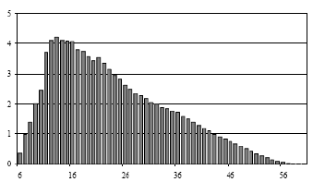
The Traditional fischer tropsch product
Traditional FT Reactor Product
Diesel
WAX
Weight percent
Carbon Number

Slide 10
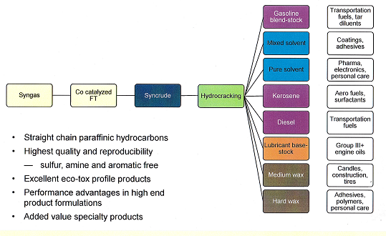
Traditional FT plant products:
Multiple products just a headache for small producers

Slide 11
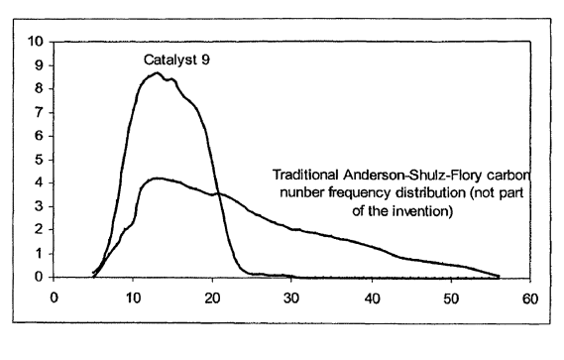
Comparison of World-Scale FT Plant with Simple Small Verdis Plant
Steam reformer
Hydrogen
Manufacture
Products
%
LPG
4
GTL reformer
FT-paraffin synthesis
Large plant
Wax hydro-
cracking
Syncrude distillation
Naphtha
23
Diesel
45
Verdis
Recycle CO₂, C1-C8
Lub base oil
unit
Lub base
Oil
24
Light detergent
feedstock
100 % Diesel
Normal
Paraffins
4
White & Green = Verdis
White & Red = World Scale
What’s the secret?
The Patented Verdis FT -catalyst does not make wax !
100
FT Catalyst Product distribution
Relative amount
Verdis
Carbon number

Slide 12
VERDIS BUIlds Small FT plants
The economies of scale are not available for
small FT plants:
Must compensate with
new chemistry and engineering
and a
Narrow, high-value product slate
SPE-xxxxxx-MS • Optimum Process Design for Gas-to-Diesel Conversion• Dr. Conrad Ayasse

Slide 13
Verdis process simplified schematic
Feed
Reformer
Syngas conditioning
To power generation for inerts control
Reactor tail
gas recycle
FT Reactor
Waste gas recycle
Product conditioning
SPE-177660-MS • New Syngas Reforming Solutions for Enhanced Gas to Diesel Conversion • Dr. Conrad Ayasse

Slide 14
Consequences of operating parameters
Fischer Tropsch is a multi-variable process.
One must select the BEST combination
SPE-xxxxxx-MS • Optimum Process Design for Gas-to-Diesel Conversion• Dr. Conrad Ayasse

Slide 15
High Syngas inert content
+ Easier heat control
Uses air instead of reformer oxygen: Eliminates oxygen plant
Vessels larger
Syngas compression costs higher
Lower CO conversion rates
Lower liquid rates: Loss of lighter components
Lower carbon efficiency
SPE-177660-MS • New Syngas Reforming Solutions for Enhanced Gas to Diesel Conversion • Dr. Conrad Ayasse

Slide 16
Smaller catalyst particle size
+ Higher activity
- Exotherm difficult to control
- Higher wax content
SPE-177660-MS • New Syngas Reforming Solutions for Enhanced Gas to Diesel Conversion • Dr. Conrad Ayasse

Slide 17
Microchannel FT reactors
+ Small catalyst particles
Very active
Excellent heat removal
Small FT reactors
Low pressure drop
- High pressure
High-wax product
Expensive reactors
SPE-177660-MS • New Syngas Reforming Solutions for Enhanced Gas to Diesel Conversion • Dr. Conrad Ayasse

Slide 18
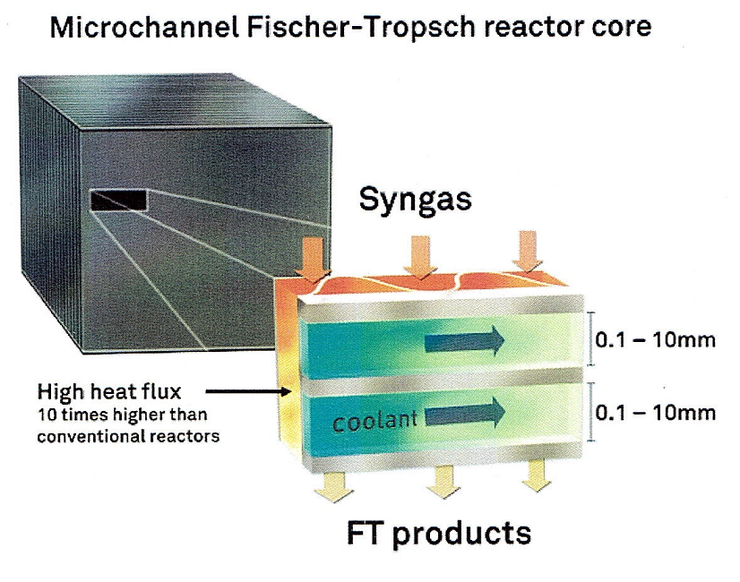
Microchannel

Slide 19
High FT tailgas recycle rate
+ Higher conversion (>2x)
Improved C5+ selectivity
Improved catalyst life
Requires a booster compressor
Requires tailgas reheating
SPE-177660-MS • New Syngas Reforming Solutions for Enhanced Gas to Diesel Conversion • Dr. Conrad Ayasse

Slide 20
High reactor temperature
+ Higher CO conversion
Lower C5+ selectivity
Higher exotherm
Shorter catalyst life
Higher operating costs
SPE-177660-MS • New Syngas Reforming Solutions for Enhanced Gas to Diesel Conversion • Dr. Conrad Ayasse

Slide 21
High reactor pressure
+ Smaller plant
Higher CO conversion
Higher wax content
Higher compression costs
Possible safety issue
SPE-177660-MS • New Syngas Reforming Solutions for Enhanced Gas to Diesel Conversion • Dr. Conrad Ayasse

Slide 22
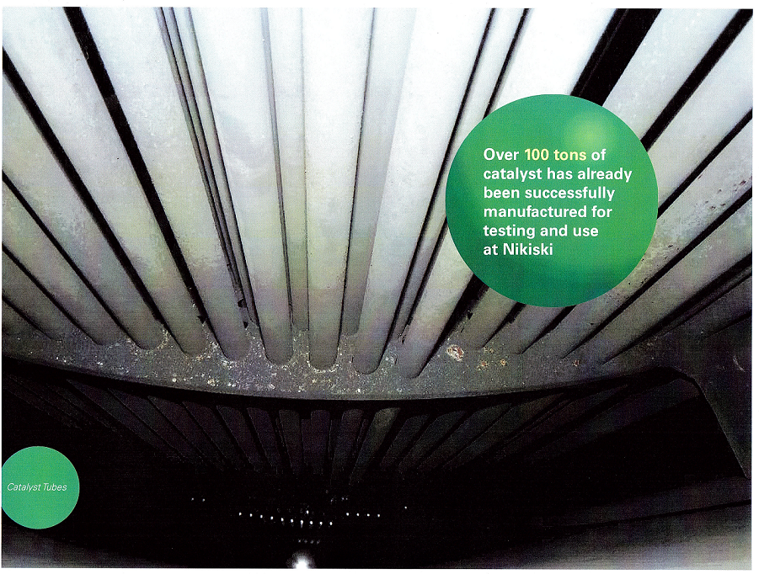
Traditional FT Reactor
Shell & narrow tube
BP FT Reactor

Slide 23
Shell and tube reactor
+ The standard for World-scale plants
Expensive
Poor use of reactor space <30%
Must be high because of tube sheet cost
High pressure drop
Limits catalyst particle size
Not possible offshore
SPE-177660-MS • New Syngas Reforming Solutions for Enhanced Gas to Diesel Conversion • Dr. Conrad Ayasse

Slide 24
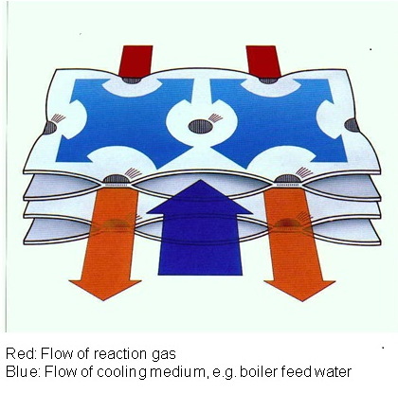
Thermoplate Reactor

Slide 25
Plate reactor
+ Less expensive
Double the catalyst capacity
Squat shape feasible, so
Can use smaller particles
Low pressure drop
Can replace sections
33% more efficient for heat exchange
Can fill off-site
SPE-177660-MS • New Syngas Reforming Solutions for Enhanced Gas to Diesel Conversion • Dr. Conrad Ayasse

Slide 26
Thermoplate Reactor
Proven in other exothermic reactions
Alternating flow channels between plates
Can have any L/D ratio (shape)
Internal catalyst modules replaceable- can fill off-site
33% higher surface area for better heat exchange than S & Tube
Catalyst density double that of S&Tube reactors
Lower cost than Shell & Tube

Slide 27
VERDIS OPERATING CONDITIONS
Low pressure to minimize compression energy
150 psig rather than 350 psig
Low reaction temperature:
185-220 ºC rather than 220-240 ºC to optimize C5+ selectivity
and increase catalyst life
Uses high tail gas FT reactor recycle rate to maximize conversion and C5+ selectivity
Waste gas circulation to oxygen-blown reformer for high carbon conversion efficiency
Use of Verdis FT catalysts to eliminate wax formation
Separator configurations can isolate fractions inexpensively
SPE-177660-MS • New Syngas Reforming Solutions for Enhanced Gas to Diesel Conversion • Dr. Conrad Ayasse

Slide 28
Comparison of Verdis catalyst with traditional catalysts
Has lower conversion per volume of catalyst based on surface area
But, has equal turnover rate
Produces no wax, so eliminates hydrocracker and hydrogen recovery costs
Operates at lower pressure (<200 psi)
Produces less low end volume than cumulative from Traditional plant
Liquid product can be tailored to clean-burning Jet Fuel or Diesel
Higher value product (possibly retail Diesel or Jet Fuel)
Ideal blending stock : has zero sulphur and very high Cetane Number (78)

Slide 29
Comparison of Verdis catalyst with traditional catalysts…. continued
Because it operates at a lower temperature -
Catalyst has a longer life:
Is less prone to reaction with support to make inactive cobalt species (e.g. cobalt aluminate)
Is less prone to oxidation (lower temperature and lower surface area)
Is less prone to sintering (larger crystallites are less mobile)

Slide 30
Unique Verdis wax-free catalyst
The FT liquid product slate
can be varied
with catalyst changes
SPE-177660-MS • New Syngas Reforming Solutions for Enhanced Gas to Diesel Conversion • Dr. Conrad Ayasse

Slide 31
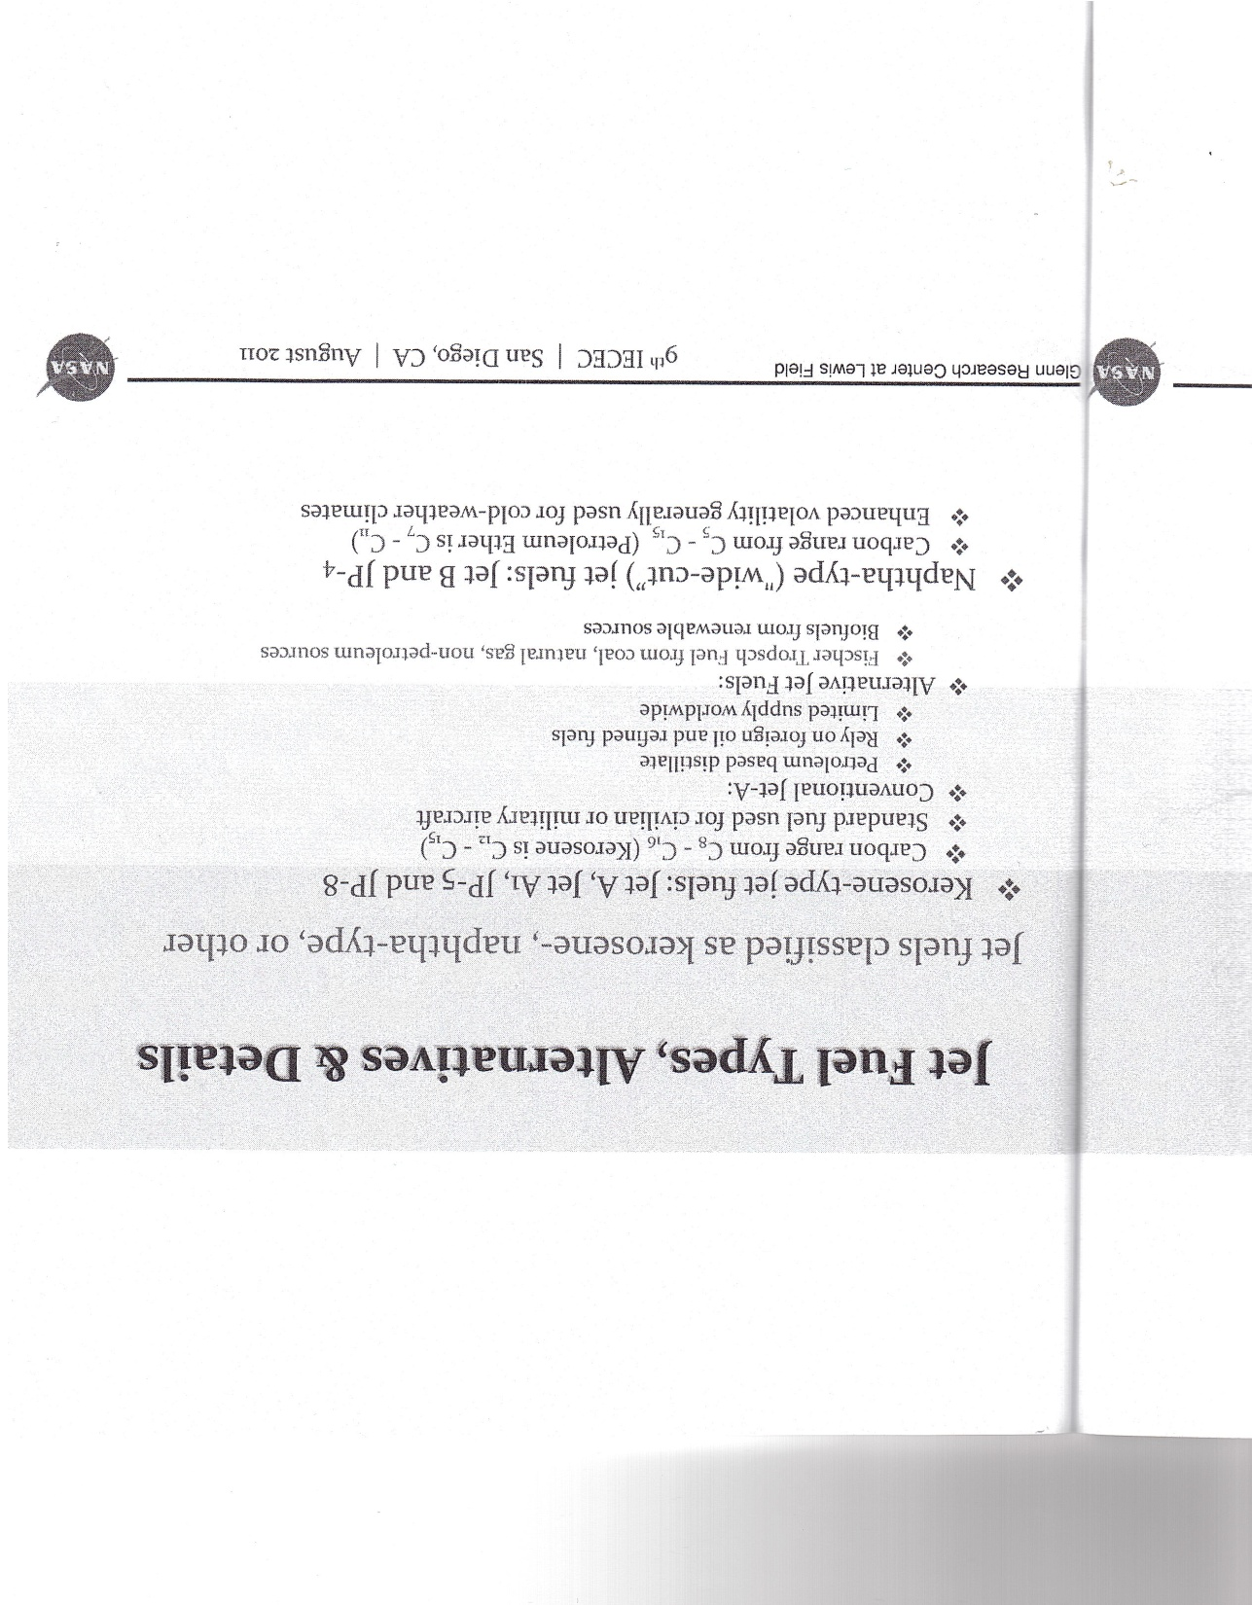
C8-C16
C5-C15
FT Jet Fuel has been used in both military planes and commercial airliners

Slide 32
MAKE DIESEL
Examples of controlling product distribution
US Patent 8,053,481
CDN Patent 2,748,216
Now assigned to Canada Chemical Corporation

Slide 33
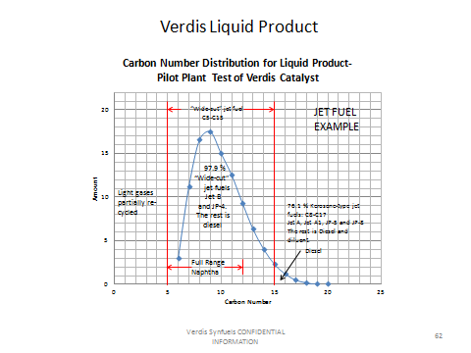
VERDIS 2 PILOT TEST (2014)
SPE-177660-MS • New Syngas Reforming Solutions for Enhanced Gas to Diesel Conversion • Dr. Conrad Ayasse

Slide 34
Verdis 3 Liquid carbon number
High-conversion catalyst, 2016
Weight fraction
NGLs
Diesel
Wide-cut Jet fuel
Carbon Number
SPE-177660-MS • New Syngas Reforming Solutions for Enhanced Gas to Diesel Conversion • Dr. Conrad Ayasse

Slide 35
_{Tailgas COMPOSITION}
Component Mol%
H₂ 39.0
CH₄ 28.8
CO 27.6
CO₂ 1.3
C2 1.2
C3 1.6
C4 0.1
C5 0.4
C6+ 0.1
Total 100
Single-pass CO Conversion 83-88%
Waste to Reformer gives >90% conversion to liquids
SPE-177660-MS • New Syngas Reforming Solutions for Enhanced Gas to Diesel Conversion • Dr. Conrad Ayasse

Slide 36
Disposal of Waste gas to
Control inerts build-up
Burn to raise steam
Burn for power generation
Send to Reformer
VERDIS process efficiency if sent to reformer:
7500-9300
scf methane equivalent/bbl liquid
SPE-177660-MS • New Syngas Reforming Solutions for Enhanced Gas to Diesel Conversion • Dr. Conrad Ayasse

Slide 37
PROPRIETARY VERDIS FT CATALYSTs
Unique FT Catalysts*
    Completely eliminates wax generation- Don’t need hydrocracker
    Can be optimized to produce naphtha, aviation fuel or diesel
    Designed for low pressure operation
    Ideal for Flare Gas and Biogas
    High carbon efficiency: 7500-9300 scf methane/bbl
    *Patented in 24 Countries
    *Patents held by Canada Chemical Corporation in 24 Countries
SPE-177660-MS • New Syngas Reforming Solutions for Enhanced Gas to Diesel Conversion • Dr. Conrad Ayasse

Slide 38
Thank you !
Any questions?
SPE-177660-MS • New Syngas Reforming Solutions for Enhanced Gas to Diesel Conversion • Dr. Conrad Ayasse

